Slide 1
PROSES TERBENTUKNYA ENERGI LISTRIK
BENDA
MOLEKUL
PROTON
NEUTRON
ELEKTRON
ATOM

Slide 2
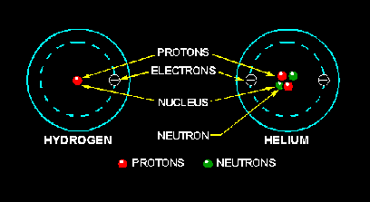
ATOMS
Notes:
‹#›

Slide 3
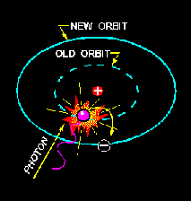
Energy Levels

Slide 4
DEFINISI LISTRIK
GERAKAN ELEKTRON DARI POSISI YANG BERMUATAN POSITIP MENUJU TEMPAT YANG BERMUATAN NEGATIP
CATATAN :
KECEPATAN ELEKTRON/LISTRIK
ADALAH 3X10⁸ m/detik =300.000km/dt

Slide 5
PROSES TERJADINYA LISTRIK
SECARA TERMIS ( PANAS )
CONTOH : - TERMO KOPEL, PETIR dll.
SECARA KIMIAWI
CONTOH : - BATU BATERREY, ACUMULATOR/AKI dll.
SECARA ELEKTROMAGNETIS
CONTOH : - DINAMO SEPEDA MOTOR/MOBIL, GENERATOR,
MIKROPONE dll.

Slide 6
Basic Sources of Electricity
Friction (gesekan)
Chemical Action (kimiawi)
Light (cahaya)
Heat (panas)
Pressure (tekanan)
Magnetism (magnetis)
‹#›

Slide 7
PROSES TERMIS
APABILA DUA BUAH BATANG LOGAM YANG BERLAINAN JENIS SALING DIHUBUNGKAN DAN PADA LOGAM TERSEBUT MENERIMA ENERGI TERMIS/PANAS, MAKA KEDUA UJUNG LOGAM TERSEBUT TIMBUL
GAYA GERAK LISTRIK

Slide 8
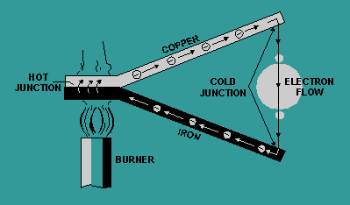
Voltage Produced by Heat

Slide 9
PROSES PANAS

Slide 10
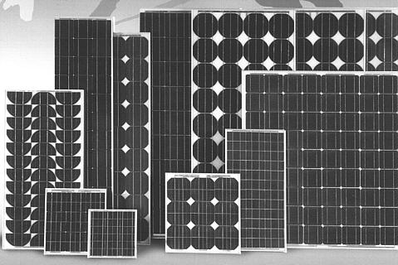
Photovoltaic Cell
‹#›

Slide 11
Photovoltaic Cell
Schematic symbol
_
+
Physical description
Sunlight
L
_
N type semiconductor
+
P type semiconductor
Specifications: 1 cell produces 1 Watt and .5 Volts
Cells can be connected into arrays.
Arrays are build with cells in series and parallel.
‹#›

Slide 12
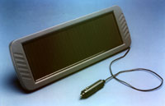
Photovoltaic Cell Application
Used to keep solar powered cars charged when not being driven.
‹#›

Slide 13
Photoresistive Cells
Schematic symbol
‹#›

Slide 14
Photoresistive Cell Application
Resistance is proportional to the light source applied.
The circuit below uses a photoresistive call to bias the base of a transistor. The output of this amplifier could be used to power a light (Street Light).
PILOT DEVICE
+V_{CC}
+V_{OUT}
AC OR DC
‹#›

Slide 15
Thermocouple
Schematic symbol
_
+
Physical Description
Iron Wire
Galvanometer:
Measures very
Small currents.
Copper Wire
Thermocouple
Match
Thermocouple + Galvanometer = Pyrometer
‹#›
Group of thermocouples = Thermopile

Slide 16
Piezoelectric Effect
Definition: The property of some crystals (i.e. Quartz) that when a pressure is exerted on one axis, a proportional voltage is present on the other axis.
Physical Description:
pressure
electrical waves
e-
Sound waves
Quartz
Crystal
Output
‹#›

Slide 17
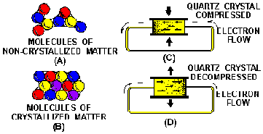
Voltage Produced by Pressure
Charged Bodies
Charged Bodies
Charged Bodies

Slide 18
PROSES KIMIAWI
TERBENTUKNYA LISTRIK KARENA PERCAMPURAN/REAKSI KIMIA ANTARA BEBERAPA JENIS UNSUR KIMIA HINGGA DAPAT MENGHASILKAN ENERGI LISTRIK

Slide 19
PROSES KIMIAWI

Slide 20
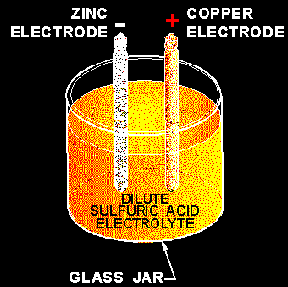
Voltage Produced by Chemical Action

Slide 21
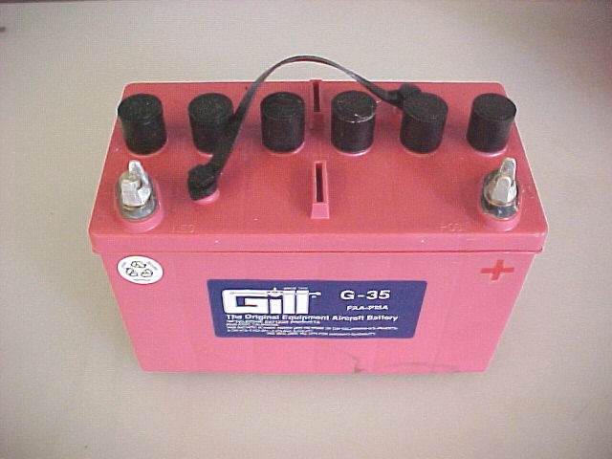
Sources of Electricity
‹#›

Slide 22
Zinc Carbon Battery Cell
Zn + H₂SO₄ + H₂O ZnSO₄ + H₂O + H₂
* plate + electrolyte + water sulfated - plate + water + hydrogen gas.
* End of Life due to H₂ blanketing around carbon rod.
Zn
C
-
+
H₂
H2SO4 + H2O
‹#›

Slide 23
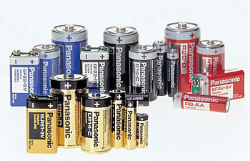
Primary Cells
D Cell
AA Cell
AAA Cell
C Cell
‹#›

Slide 24
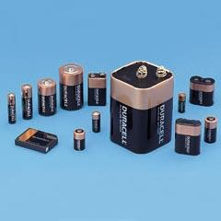
Primary Cells
‹#›

Slide 25
Primary Cells
Can not be recharged. Chemical action can not be reversed.
Defect: Polarization: H₂ blanketing around electrode.
Depolarization agent is added to prevent the H₂ blanketing around electrode . Compounds rich in oxygen (i.e. MnO₂) are used. The O₂ in the depolarization agent combines with H₂ to form H₂O. (2MnO₂ + H₂ 2MnO₃ + H₂O):
Local Action: Does not contribute to electrical energy.
‹#›

Slide 26
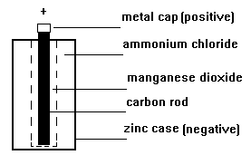
Battery Dry Cell
Flashlight Batteries: Zinc-carbon Cell
‹#›

Slide 27
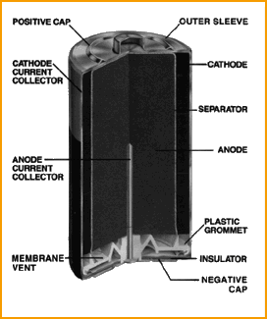
AA Alkaline Cell
Anode: Manganese Dioxide
Cathode: Zinc Powder
Electrolyte: Caustic Alkali
Separator: Separates + & -
‹#›

Slide 28
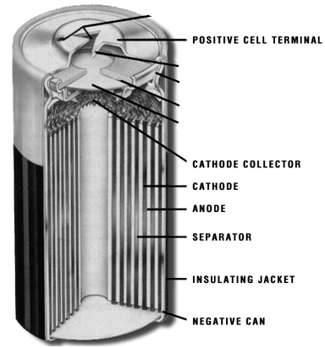
Lithium Cell
Lithium is bonded to a thin layer of conductive metal and has a porous separator between it and the cathode.
This design allows for a large surface area, providing a large reaction surface & higher discharge rates compared to other Lithium cells.
‹#›

Slide 29
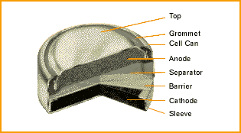
Silver Oxide Cell
Uses amalgamated zinc anode, silver oxide as the cathode material, & a potassium hydroxide electrolyte.
Silver oxide cells are ideal for miniature devices where space is limited.
Voltage: 1.5 to 1.2 V
Uses: Watches
‹#›

Slide 30
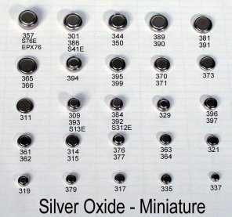
Silver Oxide Cell
‹#›

Slide 31
Secondary Cells
Can be recharged or restored.
Chemical action can be reversed.
‹#›

Slide 32
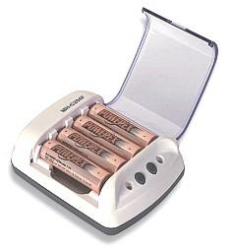
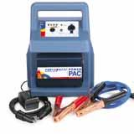
Battery Chargers
Used to restore the charge on rechargeable batteries.
Used for: AA batteries and car batteries.
‹#›

Slide 33
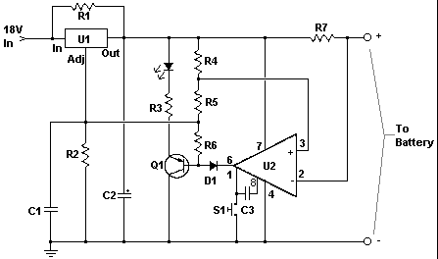
Battery Chargers Schematic
‹#›

Slide 34
Battery Chargers P/S Schematic
Parts of a Power Supply
* Stepdown Transformer
* Bridge Rectifier
* Filters
* Regulator
‹#›

Slide 35
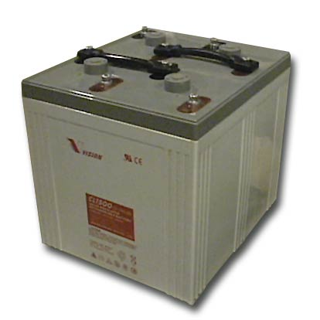
Lead Acid Battery
‹#›

Slide 36
Lead Acid Battery
Primary Chemical Reactions
Pb + PbO₂ + 2H₂ SO₄⁻² 2PbSO₄⁻² + 2H₂O + 5 e⁻
Half Cell Chemical Reactions
Pb + SO₄⁻² = PbSO₄⁻² + 2 e⁻
PbO₂ + 4 H⁺ + 2 e⁻ + SO₄⁻² = PbSO₄⁻²
charge
discharge
Pb
PbO₂
-
+
H₂ SO₄⁻²
H₂ O
Electrolyte
‹#›
Separator

Slide 37
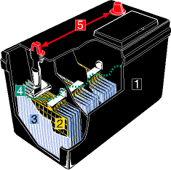
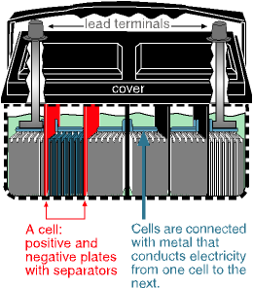
Lead Acid Battery
Terminal
Post
Terminal
Post
Plastic
Case
Plates
Separator
‹#›

Slide 38
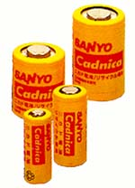
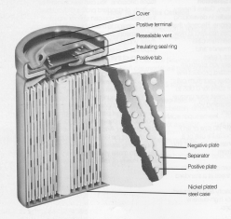
Nickel-cadmium Cell
‹#›

Slide 39
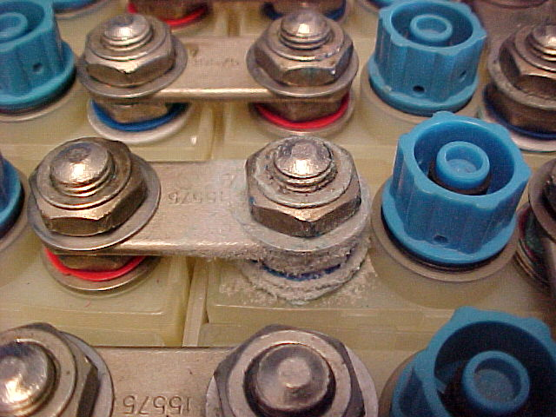
Dirty Cells cause grounds
‹#›

Slide 40
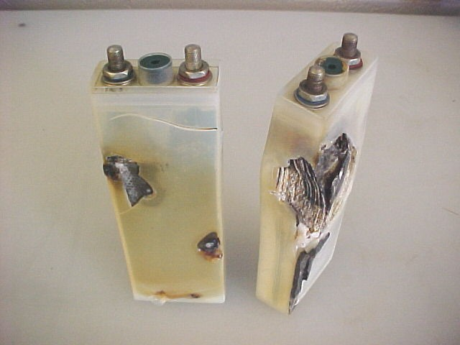
Cell Damage
‹#›

Slide 41
Batteries in Series
Physical Description
_
+
1.5V@1A
1.5V@1A
1.5V@1A
1.5V@1A
Electrical Schematic
_
_
+
_
_
+
+
+
Output 6 VDC 1A
‹#›

Slide 42
Batteries in Parallel
Physical Description
+
1.5V
@1A
1.5V
@1A
1.5V
@1A
1.5V
@1A
_
Electrical Schematic
_
_
_
_
+
+
+
+
Output 1.5 VDC 4A
‹#›

Slide 43
Batteries in Series-Parallel
Physical Description
+
1.5V
@1A
1.5V
@1A
1.5V
@1A
1.5V
@1A
_
1.5V
@1A
1.5V
@1A
1.5V
@1A
1.5V
@1A
Electrical Schematic
_
_
_
_
+
+
+
+
_
_
_
_
Output 6 VDC 2A
+
+
+
+
‹#›

Slide 44
PROSES ELEKTRO MAKNETIS
APABILA SUATU PENGHANTAR KAWAT (KUMPARAN KAWAT) DIGERAKKAN PADA MEDAN MAKNET MAKA PADA KEDUA UJUNG KUPARAN KAWAT TERSEBUT AKAN TIMBUL GAYA GERAK LISTRIK
( HUKUM FARADAY )
CATATAN:
BESAR KECILNYA TEGANGAN LISTRIK DITENTUKAN OLEH
PANJANG ATAU PENDEKNYA KAWAT PENGHANTAR

Slide 45
PROSES ELEKTRO MAKNETIS

Slide 46
KEGUNAAN MOTOR

Slide 47
Generator
Schematic symbols
G
Output waveform
Phase A
Phase B
Phase C
0
‹#›

Slide 48
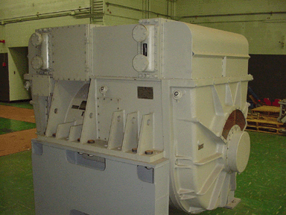
Generator
Generates 450 VAC, 60 Hz, 3 phase electricity.
‹#›

Slide 49
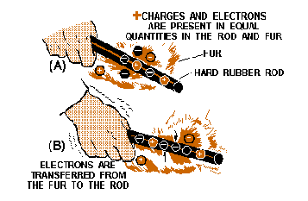
ELECTROSTATICS

Slide 50
Persiapan Praktikum
Bread Board/Project Board
Resistor (100, 220, 330, 560, 820, 1k, 2k2, 3k3, 10k, 100k, 220k, 1M) Ohm
Kapasitor (polar 10u) Farad
Dioda (1N4008, 1N4733 Zener 5.1 V, bridge)
Transformator stepdown 9 volt
Adaptor dc 12 V
DC jack female
LM2596 module DC-DC voltage converter
Kabel jumper male-male, female-male
AVO/multi meter digital

