Slide 1
Graf dalam Matlab
Kuliah Teori Graf
Smt Gasal 2018/2019

Slide 2
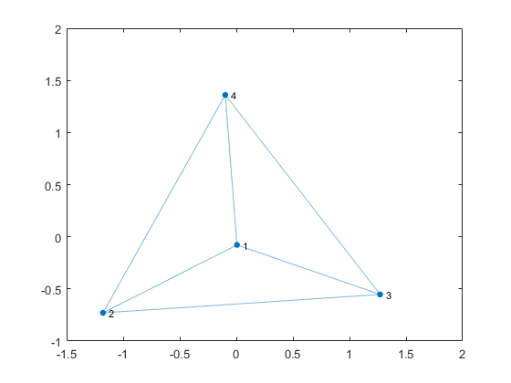
Penyajian Graf dalam Matlab
Penyajian graf tanpa label titik dan label sisi
(Default label titik/sisi: angka)
>> s = [1 1 1 2 2 3];
>> t=[2 3 4 3 4 4];
>> G = graph(s,t);
>> h = plot(G)

Slide 3
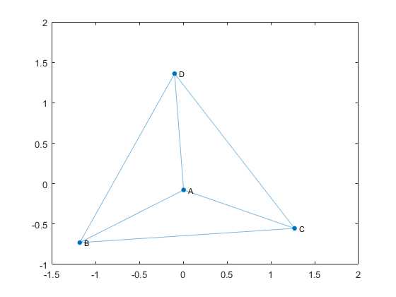
Penyajian graf dengan Matlab
Graf dengan Label Titik
>> s = [1 1 1 2 2 3];
>> t=[2 3 4 3 4 4];
>> G = graph(s,t);
>> G.Nodes.Name = {'A' 'B' 'C' 'D'}';
>> h = plot(G,'NodeLabel',G.Nodes.Name)

Slide 4
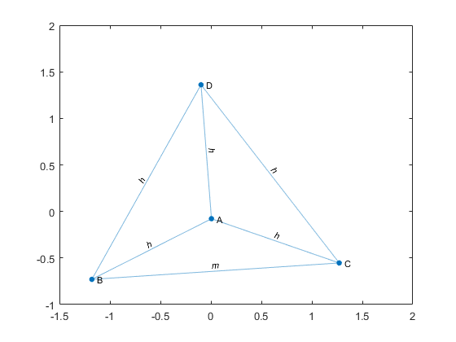
Penyajian graf dengan Matlab
Graf dengan Label Titik dan Label sisi
>> s = [1 1 1 2 2 3];
>> t=[2 3 4 3 4 4];
>> G = graph(s,t);
>> G.Nodes.Name = {'A' 'B' 'C' 'D'}';
G.Edges.Power = {'h' 'h' 'h' 'm' 'h' 'h'}';
h = plot(G,'EdgeLabel',G.Edges.Power,'NodeLabel',G.Nodes.Name)

Slide 5
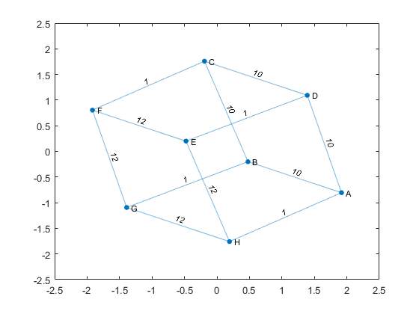
Penyajian graf dengan Matlab
Graf dengan Bobot sisi (label sisi berupa angka)
>> s = [1 1 1 2 2 3 3 4 5 5 6 7];
>> t = [2 4 8 3 7 4 6 5 6 8 7 8];
>> weights = [10 10 1 10 1 10 1 1 12 12 12 12];
>> names = {'A' 'B' 'C' 'D' 'E' 'F' 'G' 'H'};
>> G = graph(s,t,weights,names)
plot(G,'EdgeLabel',G.Edges.Weight)

Slide 6
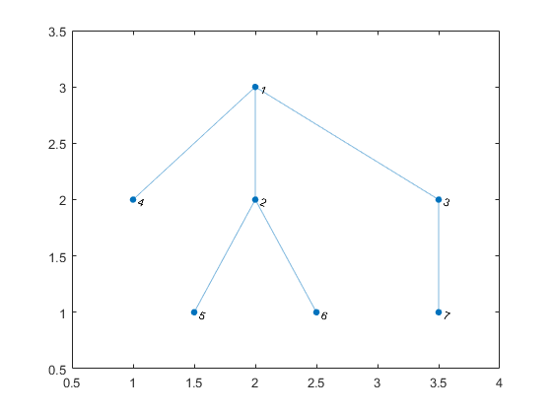
Representasi Graf dalam Matriks
>> A = adjacency(G)
A =
(2,1) 1
(3,1) 1
(4,1) 1
(1,2) 1
(5,2) 1
(6,2) 1
(1,3) 1
(7,3) 1
(1,4) 1
(2,5) 1
(2,6) 1
(3,7) 1
Matriks Adjacency
>> s = [1 1 1 2 2 3];
>> t = [2 3 4 5 6 7];
>> G = graph(s,t)

Slide 7
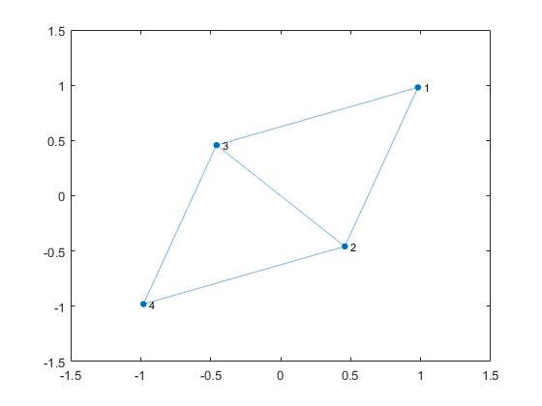
Representasi Graf dalam Matriks
Matriks Adjacency dari Graf Berbobot
>> A = [0 5 3 0;0 0 1 2; 0 0 0 11; 0 0 0 0]
A =
0 5 3 0
0 0 1 2
0 0 0 11
0 0 0 0
>> G.Edges
ans =
EndNodes Weight
________ ______
1 2 5
1 3 3
2 3 1
2 4 2
3 4 11
>> G = graph(A,'upper')
G =
graph with properties:
Edges: [5x2 table]
Nodes: [4x0 table]

Slide 8
Incidence Matrix
I = incidence(G) returns the sparse incidence matrix for graph G.
If s and t are the node IDs of the source and target nodes of the jth edge in G, then I(s,j) = -1 and I(t,j) = 1.
That is, each column of I indicates the source and target nodes for a single edge in G.

Slide 9
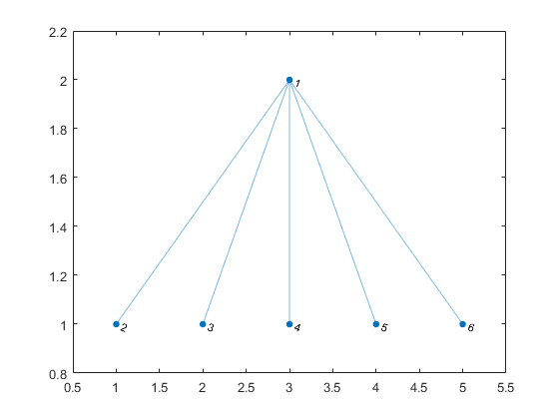
Representasi Graf dalam Matriks
Matriks Incidency
>> s = [1 1 1 1 1];
>> t = [2 3 4 5 6];
>> G = graph(s,t);
>> plot(G)
>> I = incidence(G)
I =
(1,1) -1
(2,1) 1
(1,2) -1
(3,2) 1
(1,3) -1
(4,3) 1
(1,4) -1
(5,4) 1
(1,5) -1
(6,5) 1

Slide 10
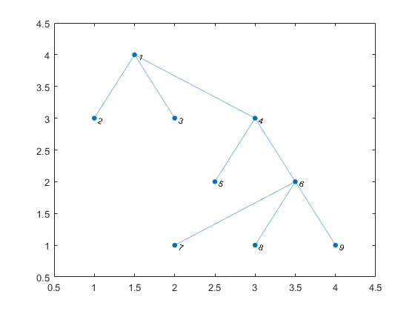
Degree of Vertices in a Graph
>> plot(G)
>> s = [1 1 1 4 4 6 6 6];
>> t = [2 3 4 5 6 7 8 9];
>> G = graph(s,t);
>> deg = degree(G)
deg =
3
1
1
3
1
4
1
1
1

Slide 11
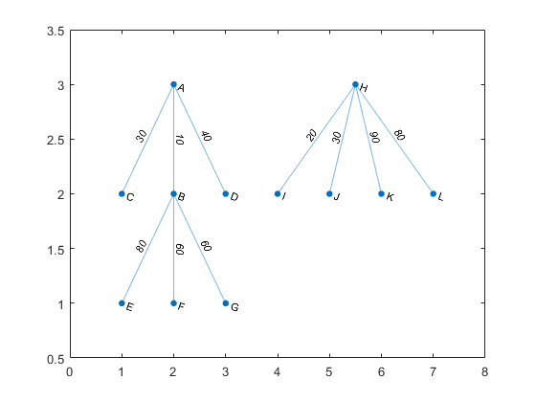
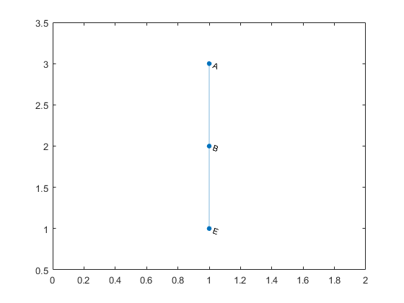
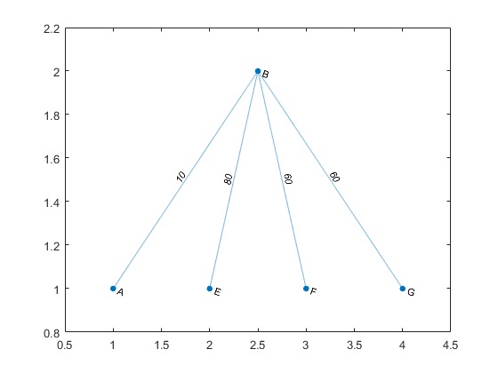
Subgraph
>> s = [1 1 1 2 2 2 8 8 8 8];
>> t = [2 3 4 5 6 7 9 10 11 12];
>> weights = [10 30 40 80 60 60 20 30 90 80];
>> names = {'A' 'B' 'C' 'D' 'E' 'F' 'G' 'H' 'I' 'J' 'K' 'L'};
>> G = graph(s,t,weights,names);
>> plot(G,'EdgeLabel',G.Edges.Weight)
>> N = neighbors(G,'B')
N =
'A'
'E'
'F'
'G'
>> H = subgraph(G, ['B'; N]);
>> plot(H,'EdgeLabel',H.Edges.Weight)
>> H = subgraph(G,{'A' 'B' 'E'})
>> plot(H)

